Slide 1
Install Node.js
Lecturer: Ngo Huy Bien
Software Engineering Department
Faculty of Information Technology
University of Science
Ho Chi Minh City, Vietnam
nhbien@fit.hcmus.edu.vn

Slide 2

Objectives
To install Node.js.

Slide 3

Contents

Slide 4

References

Slide 5
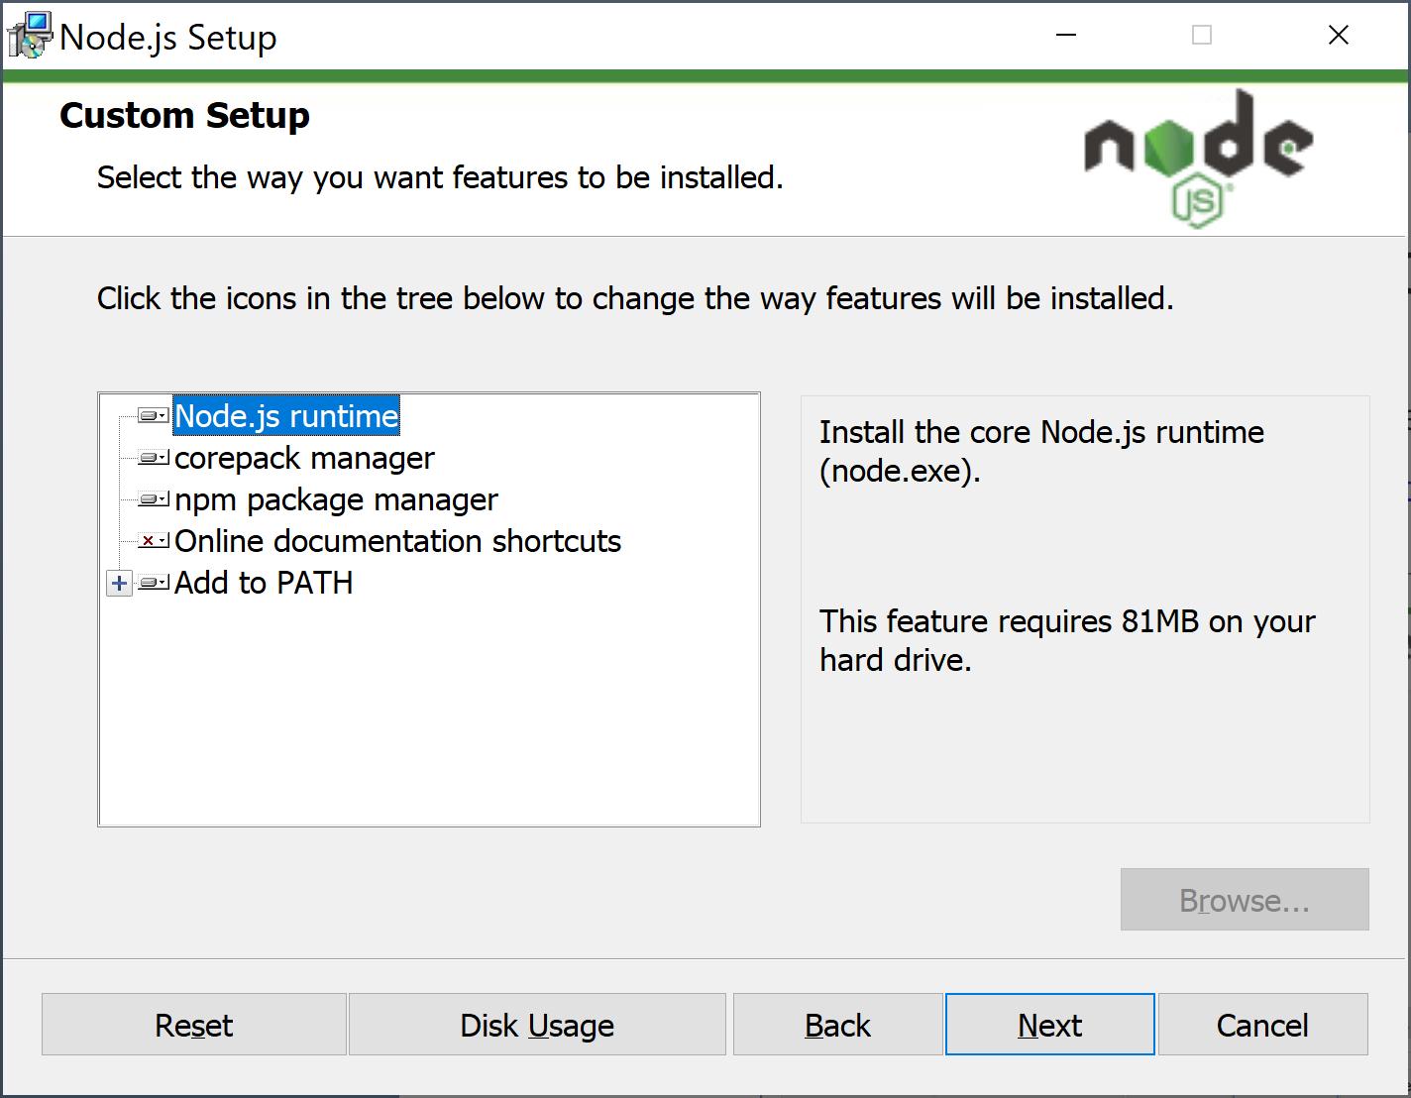
1. Install Node.js on Windows
Go to https://nodejs.org/en/download (Select the LTS tab)
Roadmap. https://nodejs.org/en/about/previous-releases

Slide 6
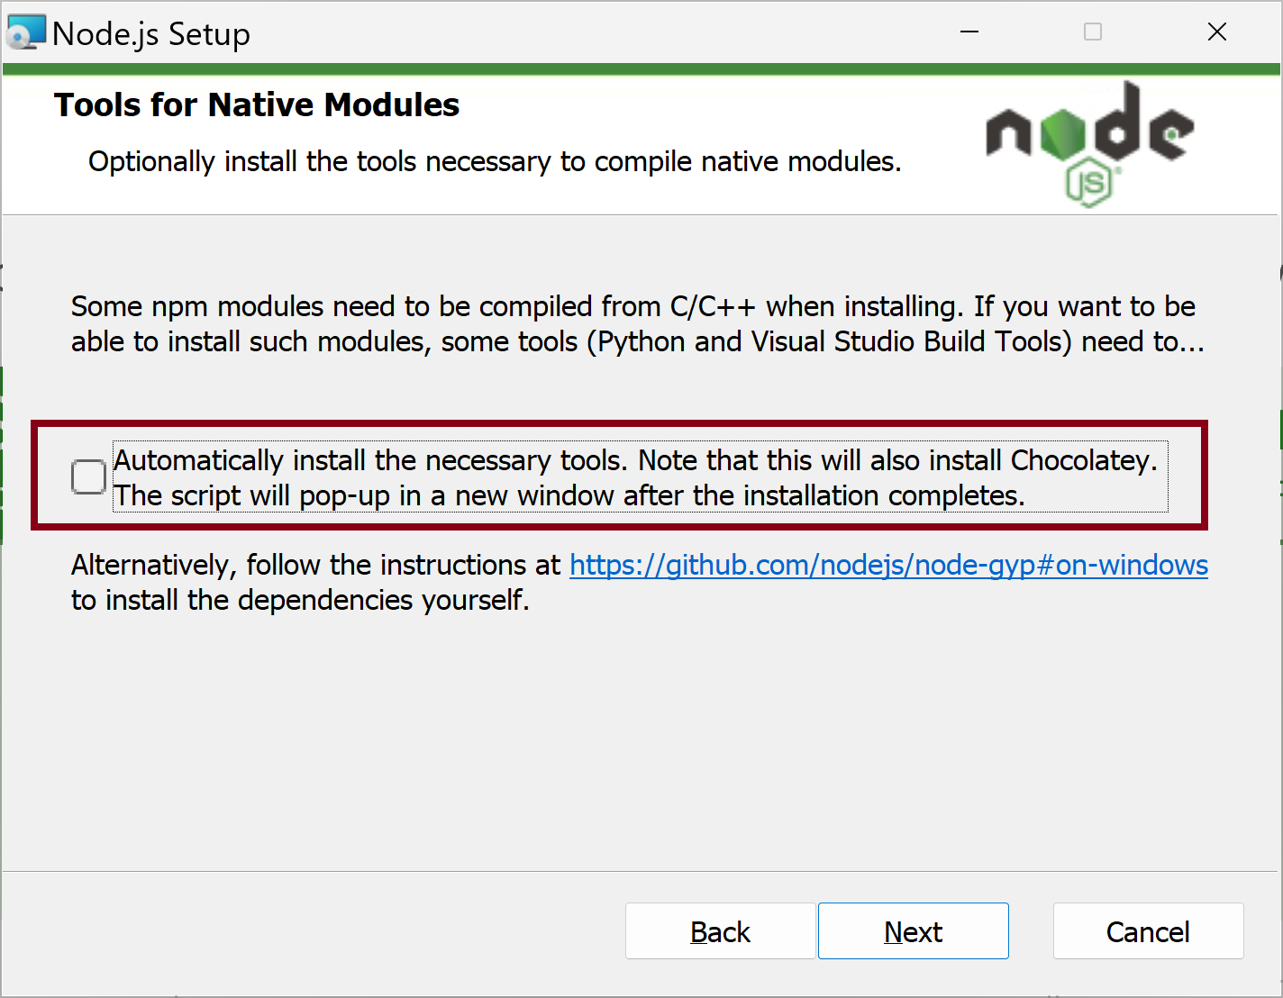
2. Do Not Select Native Modules Tools

Slide 7
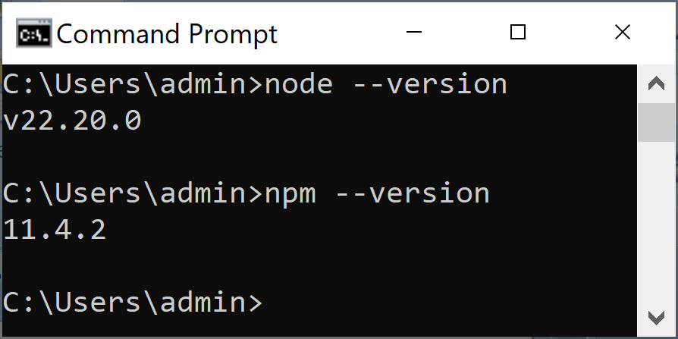
3. Verify Node.js Installation
node --version
npm --version

Slide 8
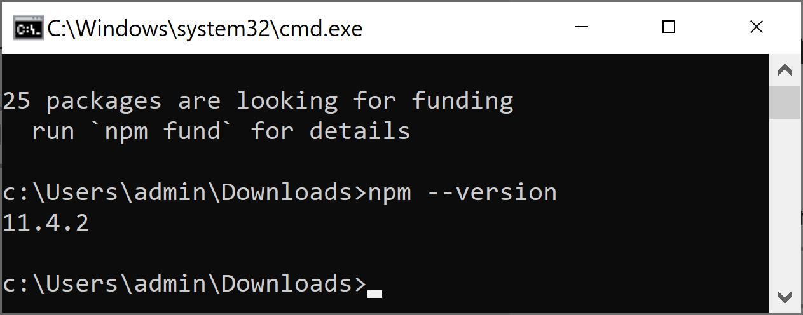
4. Upgrade npm
npm install -g npm@latest
npm --version

Slide 9


Slide 10
1. Remove Node from Ubuntu
sudo apt-get remove nodejs npm
sudo rm -rf /usr/local/bin/npm /usr/local/share/man/man1/node* /usr/local/lib/dtrace/node.d ~/.npm ~/.node-gyp /opt/local/bin/node /opt/local/include/node /opt/local/lib/node_modules
sudo rm -rf /usr/local/lib/node*
sudo rm -rf /usr/local/include/node*
sudo rm -rf /usr/local/bin/node*

Slide 11
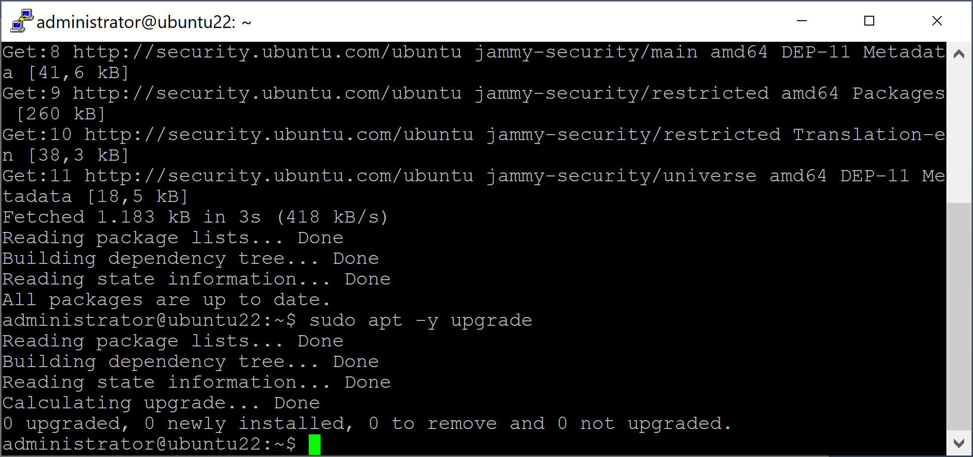
2. Update & Upgrade Ubuntu
sudo apt update
sudo apt -y upgrade

Slide 12
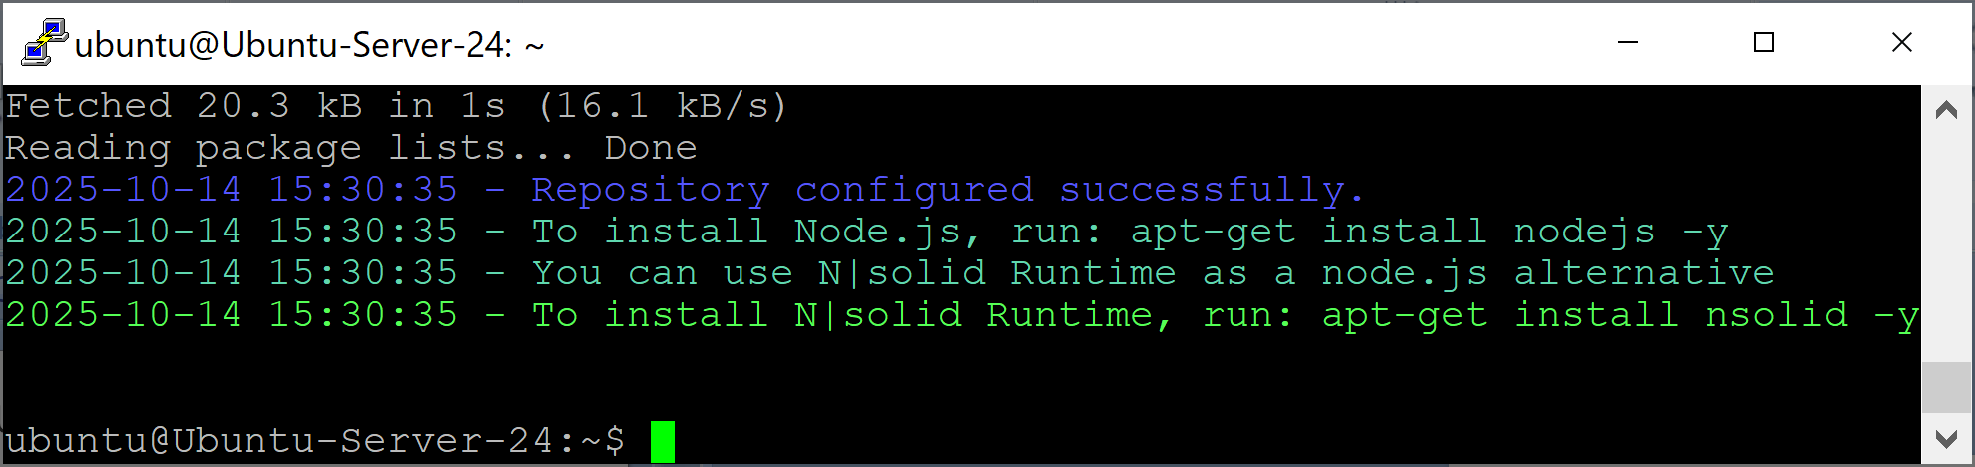
3. Download Node
Check the latest version at https://deb.nodesource.com
Get your desired Node version:
curl -sL https://deb.nodesource.com/setup_22.x -o nodesource_setup.sh
//replace 22.x with desired major version
sudo bash nodesource_setup.sh

Slide 13
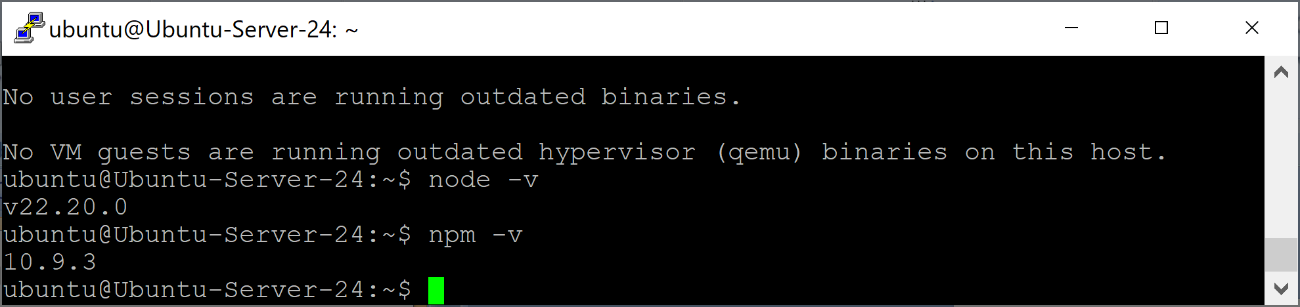
4. Install Node and NPM
sudo apt-get install -y nodejs
node -v
npm -v

Slide 15
1. Remove Node.js from macOS
sudo rm -rf ~/.npm ~/.nvm ~/node_modules ~/.node-gyp ~/.npmrc ~/.node_repl_history
sudo rm -rf /usr/local/bin/npm /usr/local/bin/node-debug /usr/local/bin/node /usr/local/bin/node-gyp
sudo rm -rf /usr/local/share/man/man1/node* /usr/local/share/man/man1/npm*
sudo rm -rf /usr/local/include/node /usr/local/include/node_modules
sudo rm -rf /usr/local/lib/node /usr/local/lib/node_modules /usr/local/lib/dtrace/node.d
sudo rm -rf /opt/local/include/node /opt/local/bin/node /opt/local/lib/node
sudo rm -rf /usr/local/share/doc/node
sudo rm -rf /usr/local/share/systemtap/tapset/node.stp
sudo reboot

Slide 16
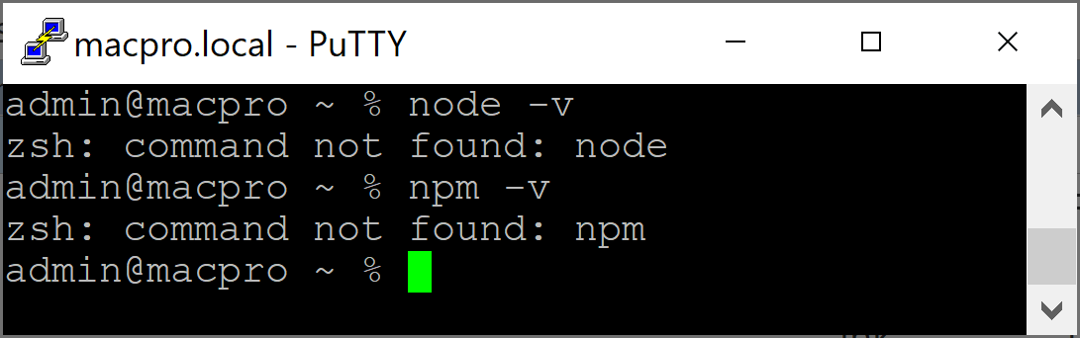
2. Verify Node.js Removal
node -v
npm -v

Slide 17
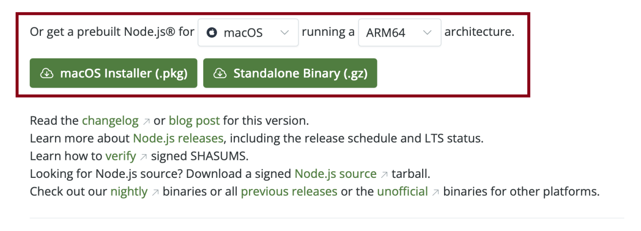
3. Download Node.js
https://nodejs.org/en/download/

Slide 18
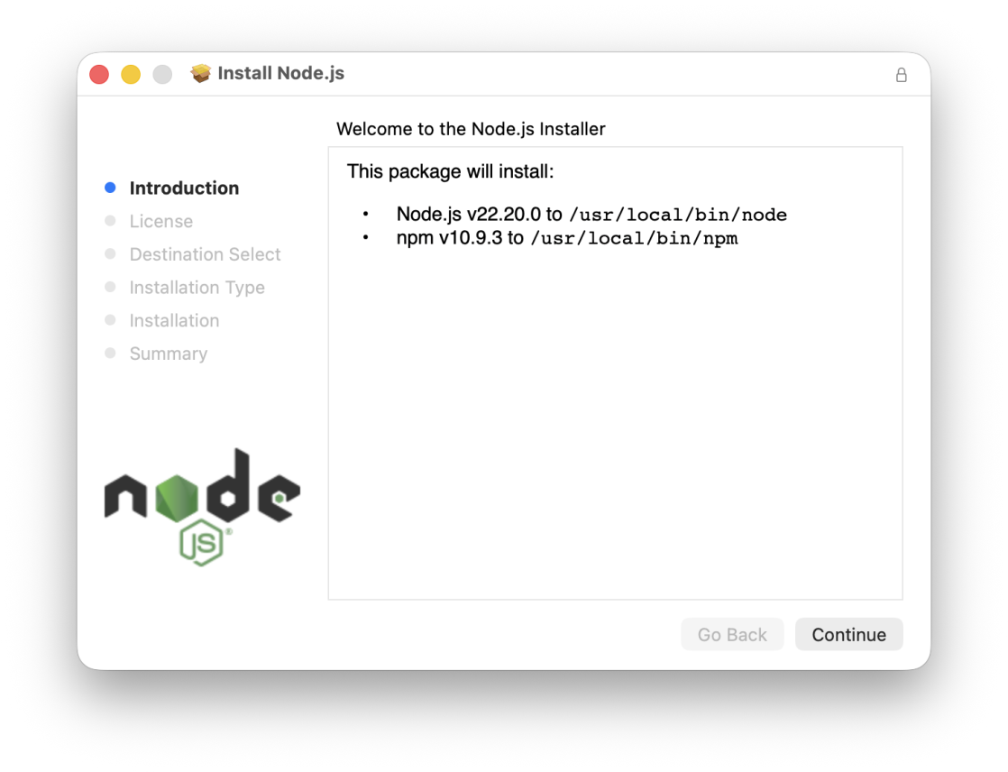
4. Install Node.js

Slide 19
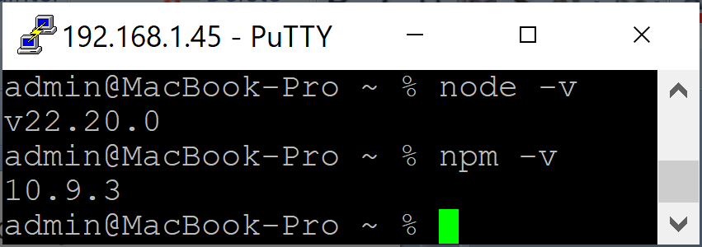
5. Verify Node.js Installation
node -v
npm -v

Slide 21
npx
Stands for Node Package Execute.
Comes bundled with npm.
Used to run executables from npm packages without installing them globally.
This downloads create-react-app temporarily (if not already installed), runs it, and then discards it.
Also ensures the local version of a tool in node_modules/.bin takes priority.
npx create-react-app my-app

Slide 23
Yarn
https://www.digitalocean.com/community/tutorials/how-to-install-and-use-the-yarn-package-manager-for-node-js
Yarn is a package manager for Node.js that focuses on speed, security, and consistency.
It was originally created to address some issues with the popular NPM package manager.
Though the two package managers have since converged in terms of performance and features, Yarn remains popular, especially in the world of React development.

Slide 24
Unique Features of Yarn
Some of the unique features of Yarn are:
A per-project caching mechanism, that can greatly speed up subsequent installs and builds
Consistent, deterministic installs that guarantee the structure of installed libraries are always the same
Checksum testing of all packages to verify their integrity
“Workspaces”, which facilitate using Yarn in a monorepo (multiple projects developed in a single source code repository)

Slide 25
1. Install yarn on Ubuntu
sudo apt install cmdtest
yarn --version

Slide 26
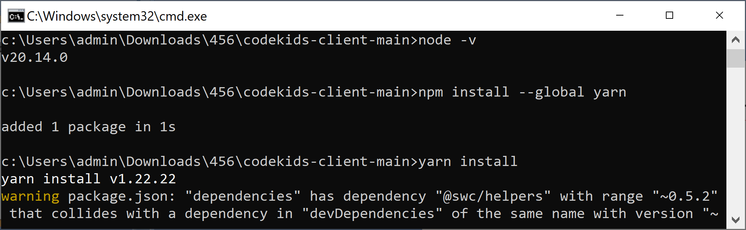
2. Install yarn on Windows
npm install --global yarn

Slide 28
Deno
https://deno.com/
Deno is the open-source JavaScript runtime for the modern web. Built on web standards with zero-config TypeScript, unmatched security, and a complete built-in toolchain, Deno is the easiest, most productive way to JavaScript.

Slide 29

Thank You & See You Again

